Slide 1



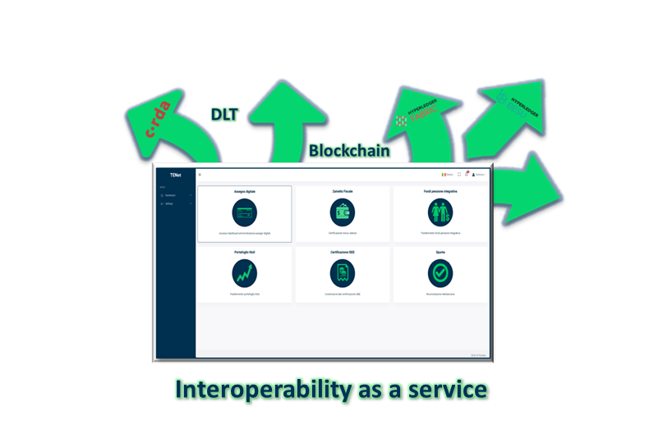

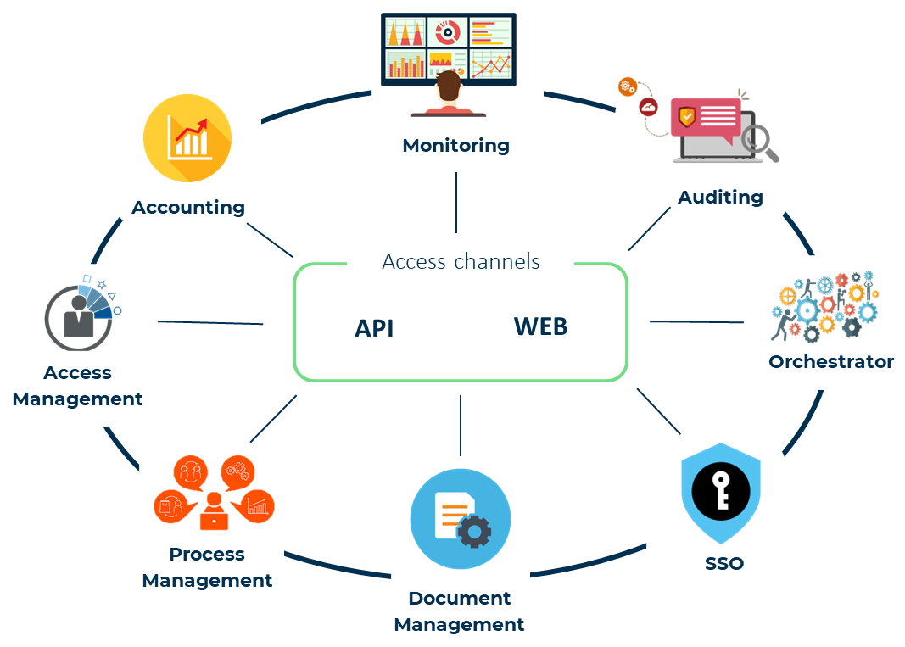
FLOWBE
(Bridging the distance)
Filiera Attrattività
Who we are
Flowbe aims to reduce the time and space distances that arise between market operators when they have to interact with each other, guaranteeing and certifying the exchange of information following a process-oriented approach to support business ecosystems.
The initiative was born from the experience of the founders gained both within a Trust Service Provider and in the banking context with particular reference to compliance in support of digital transformation
Product description
Flowbe has developed TENet (Trusted Exchange Network), a blockchain-based interoperability platform capable of orchestrating processes and enabling data sharing between different operators, with a guarantee of origin and authenticity. Flowbe's goal is to support interoperability within business ecosystems in a simple and scalable way and to certifiedly monitor the events and data that characterize a process.
The platform supports a high degree of scalability, with the possibility of hosting multiple certified interoperability processes by leveraging the same infrastructure, even when using different blockchain/DLT technologies.
(Contacts)
Tel.: 347.7777223
gianluca.bortignon@flowbe.it
www.flowbe.it

